Slide 1
CryoBiopsy Paper

Slide 2
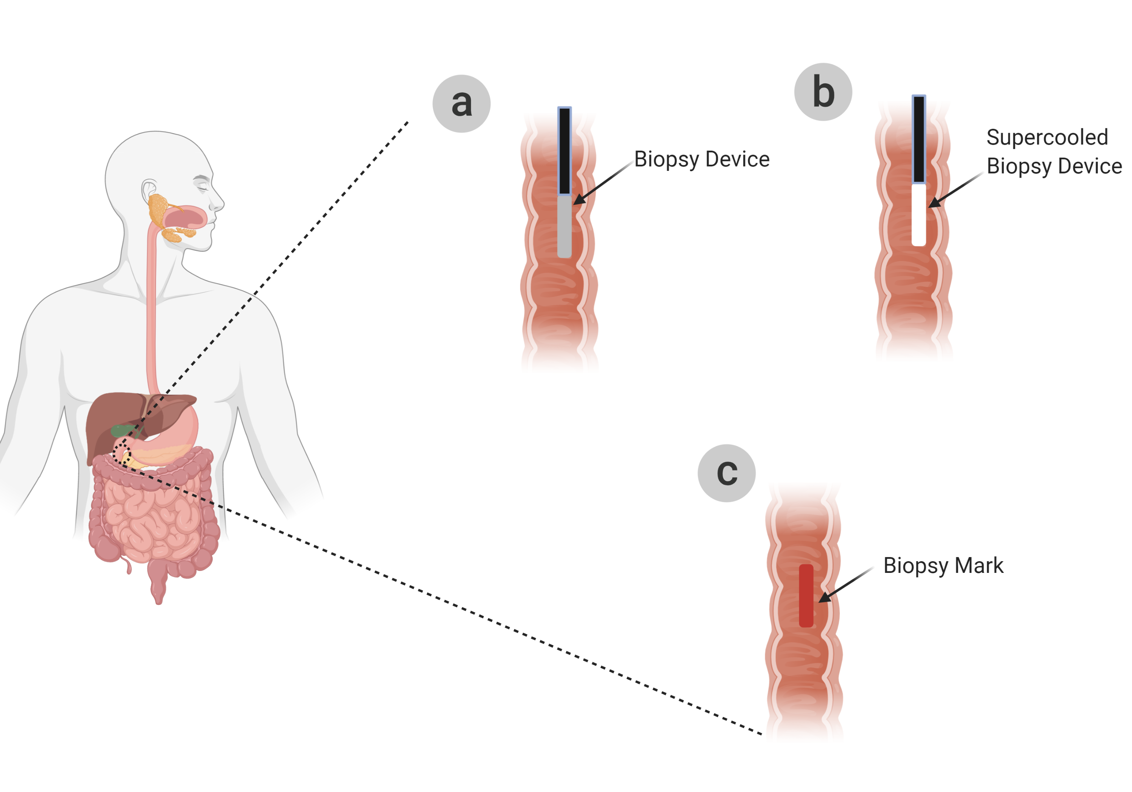

Slide 3
(a)
(b)
(c)
(d)

Slide 5
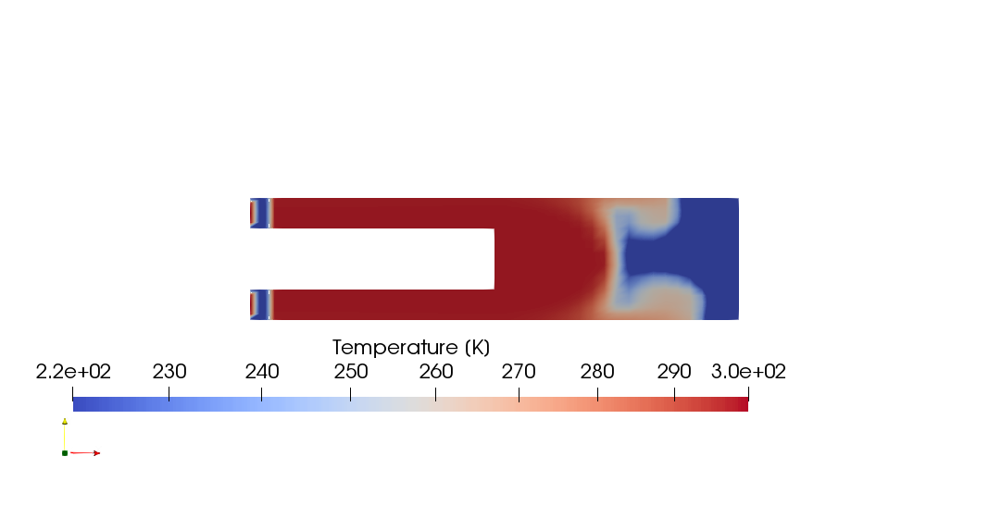
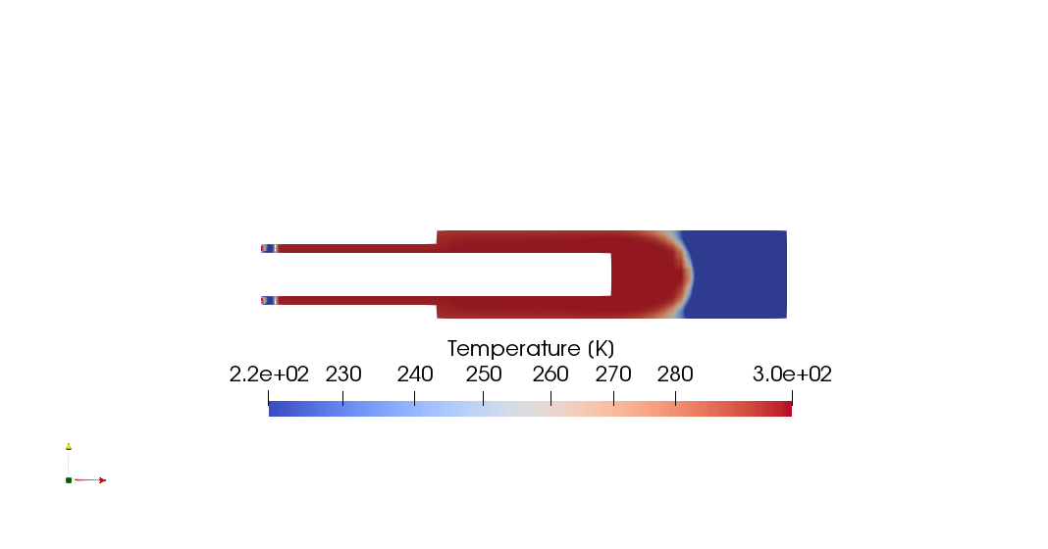
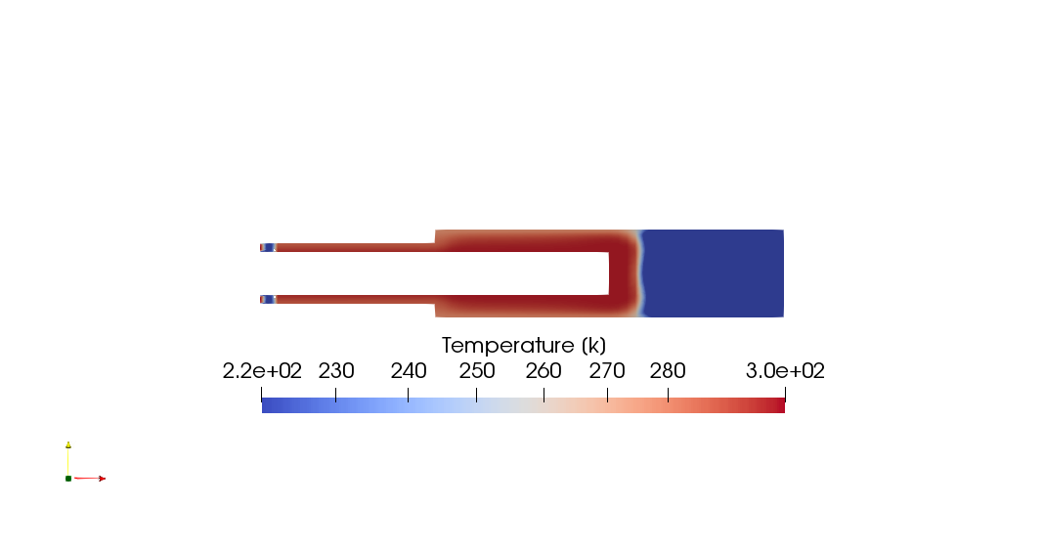
(a)
(e)
Freon out
Freon in
Tube
Metallic tip
(b)
(f)
(c)
(d)

Slide 6
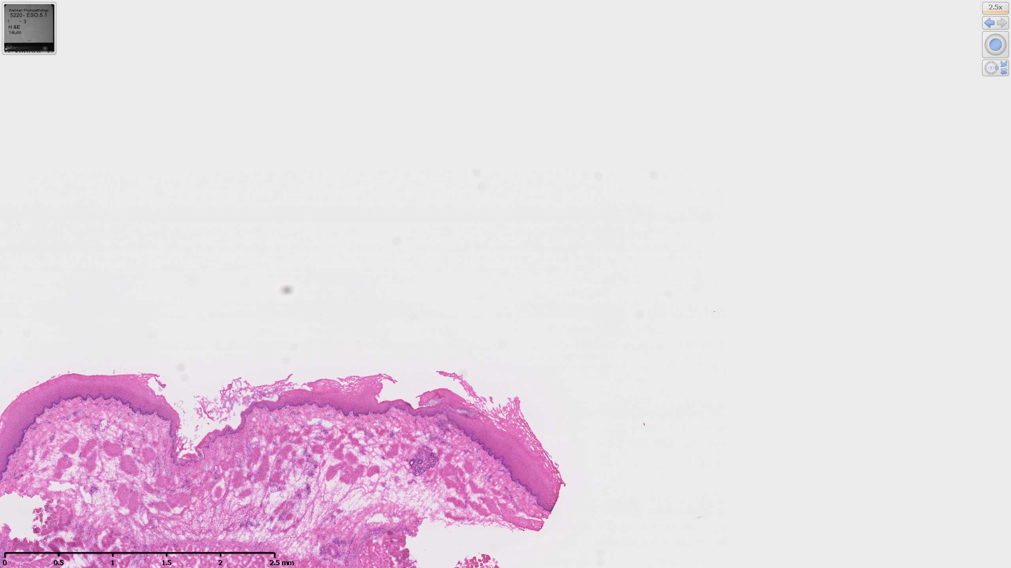
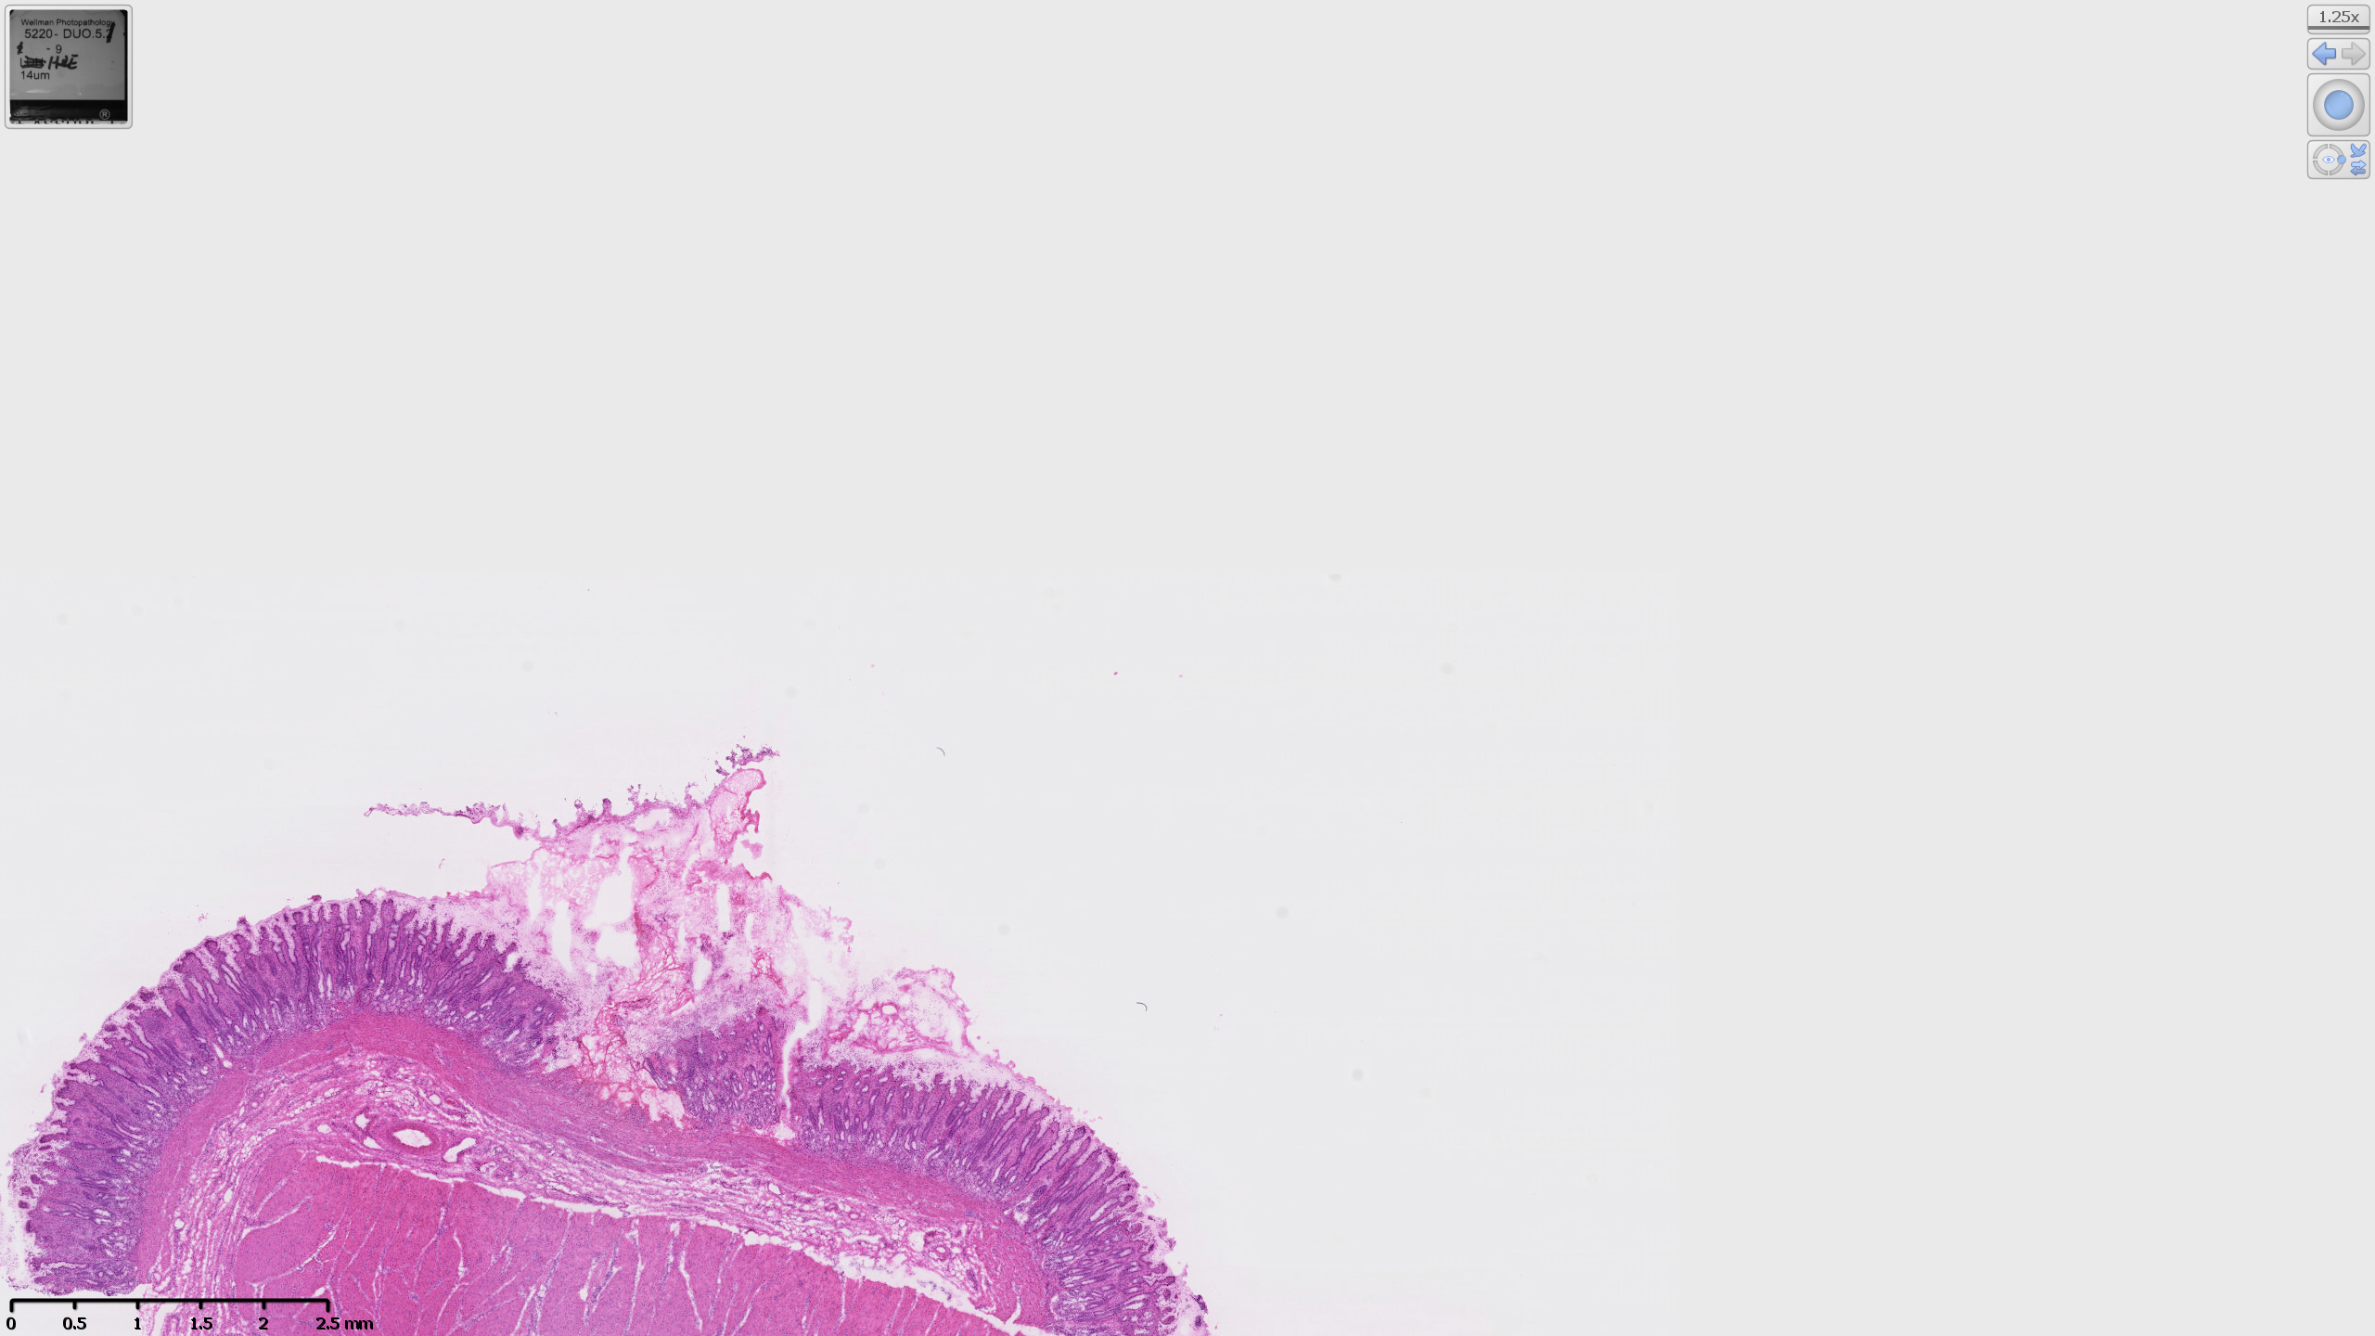
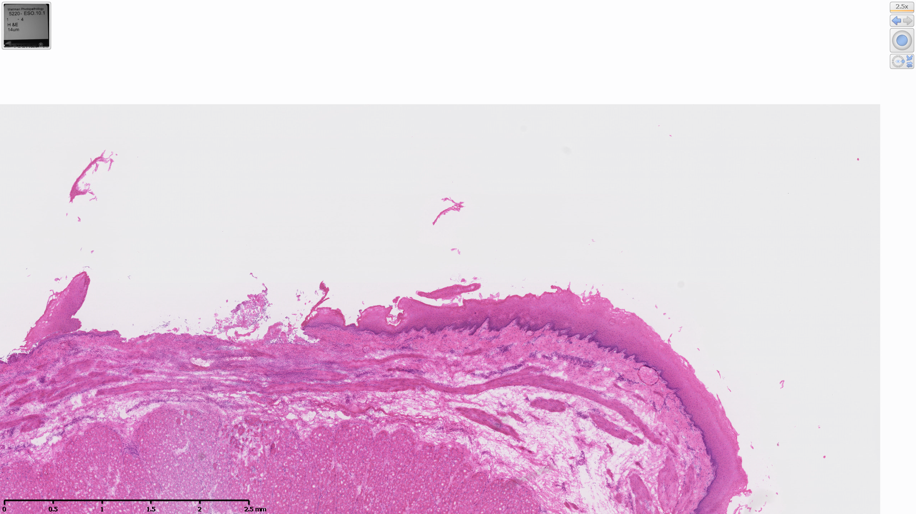
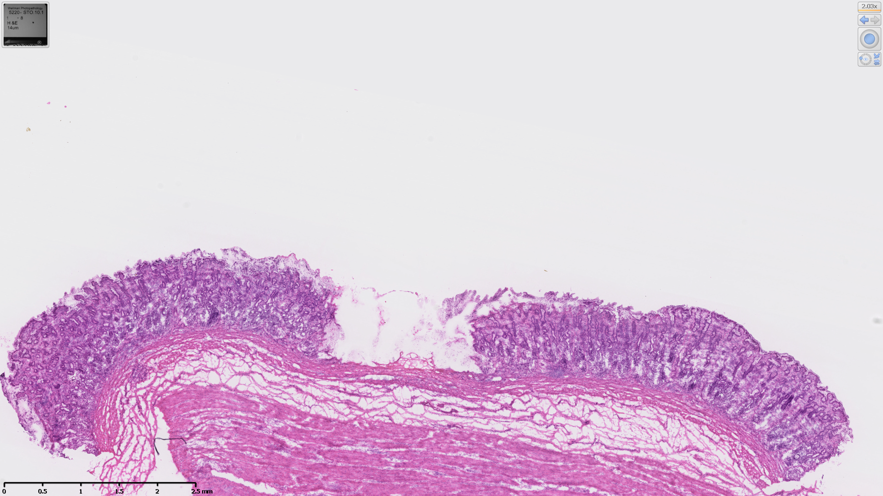
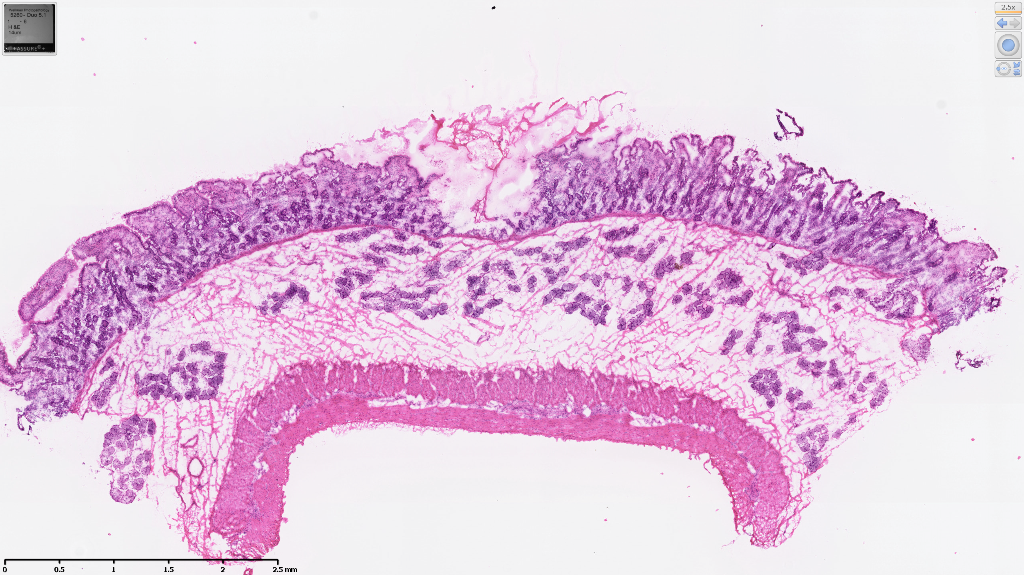
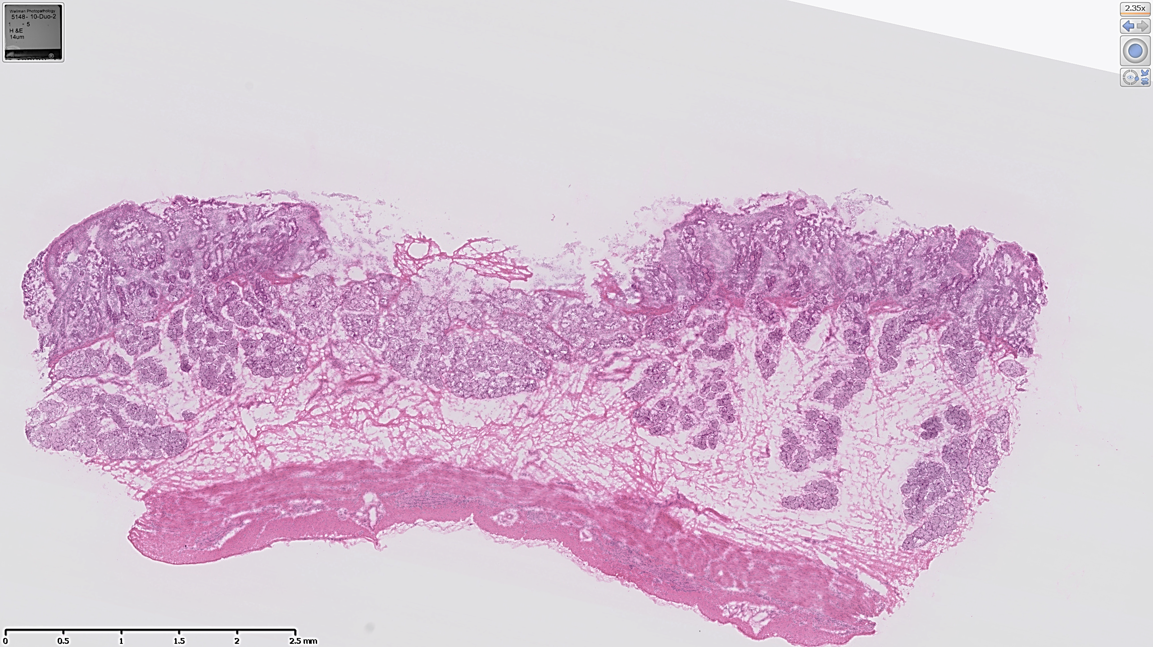
1 mm
5 Sec, Depth: 0.409 mm
1 mm
5 Sec, Depth: 0.98 mm
10 Sec, Depth: 0.452 mm
10 Sec, Depth: 1.12 mm
1 mm
5 Sec, Depth: 0.96 mm
10 Sec, Depth: 1.1 mm

Slide 7
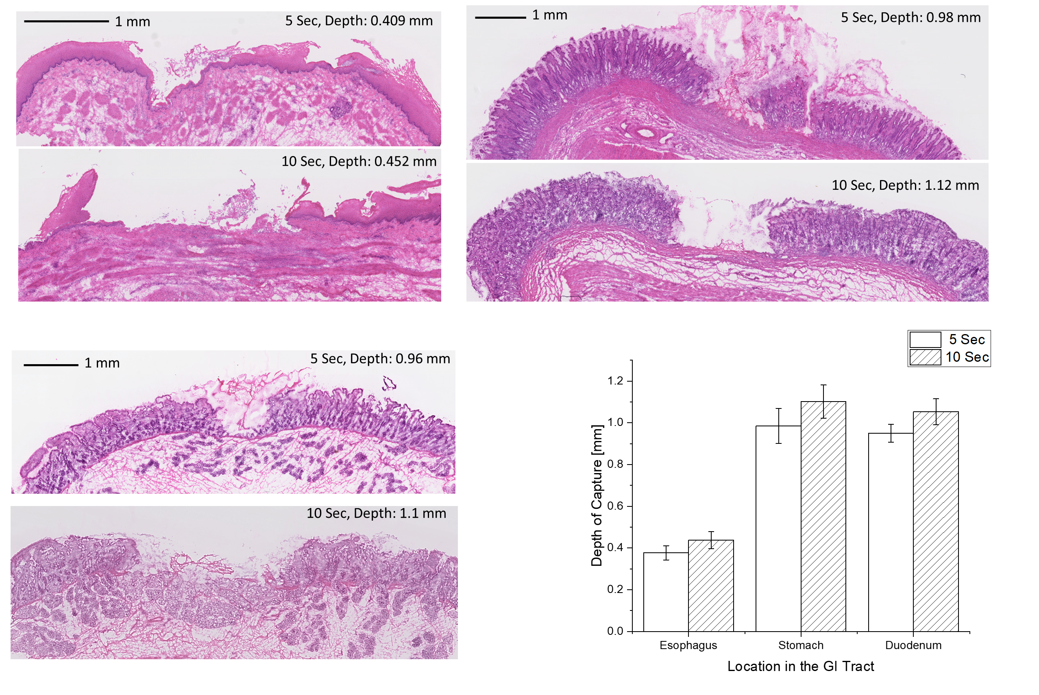

Slide 8
